Slide 1
Memory Leak
Mobile Development

Slide 2
01
Memory Leak
Introduction
Problems
02
Explain two main characters in the memory
Heap
Stack
03
Memory Management
04
Memory Management Type
Manual Memory Management
05
Automatic Memory Management
Garbage Collection
06
Some Reasons of Memory Leak
05
Examples
08
How To Avoid Memory Leak
AGENDA
Questions
09
10
References

Slide 3
MEMORY LEAK
Introduction
one of the most common issues that developers face is memory leaks.
Memory leak occurs when programmers use a memory and forget to free it
Problems
it reduces the performance
Crashing
the system stops working correctly
the application fails.
Out of Memory

Slide 4
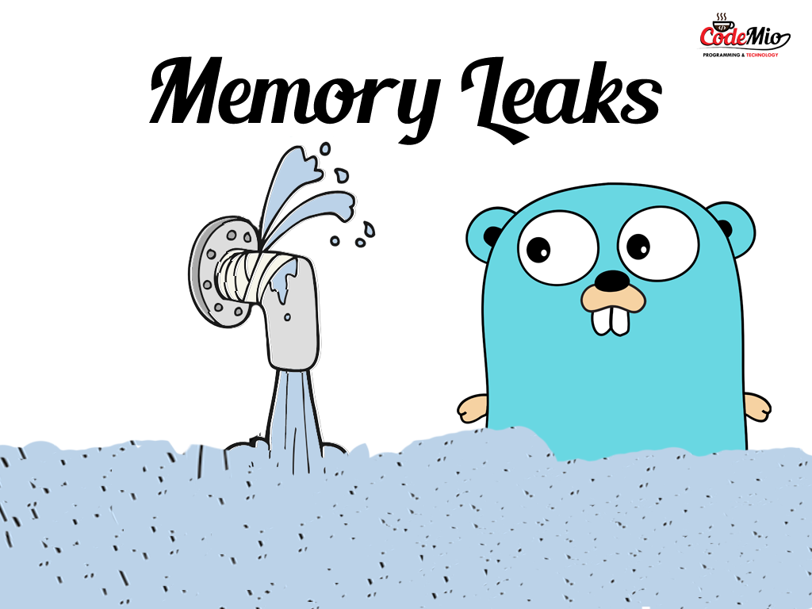

Slide 5
Main Characters in the Memory

Slide 6
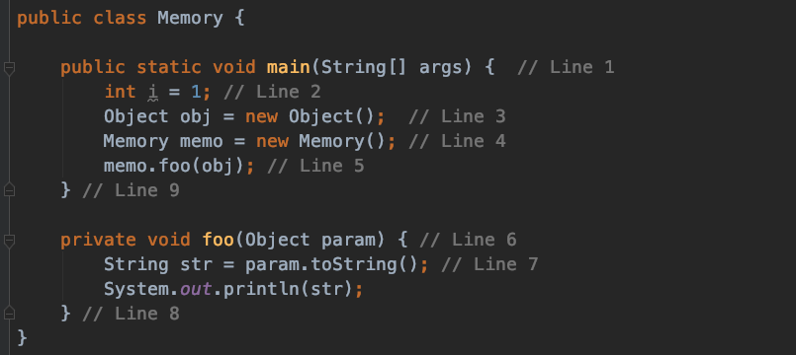
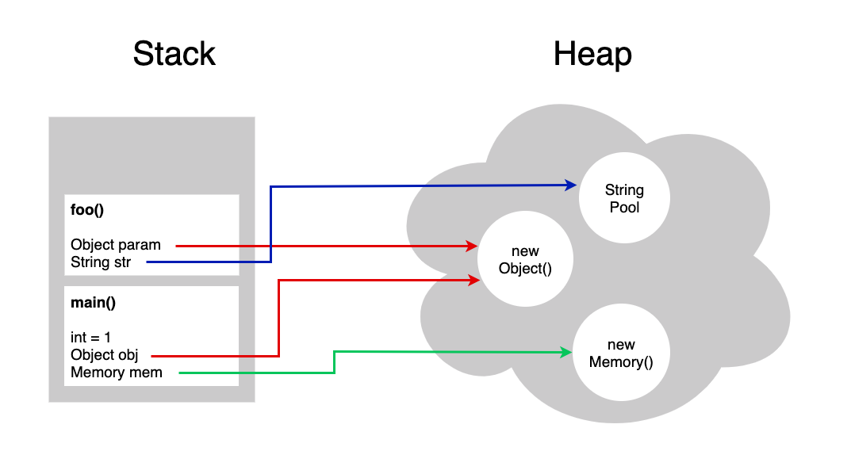
Heap
Heap space is used by runtime to allocate memory to Objects ,when we create an object, it’s always created in the Heap space.
Any object created in the heap space has global access and can be referenced from anywhere of the application.
Store in heap
Objects
Global Varrible
Stack
Stack memory is always referenced in LIFO (Last-In-First-Out) order. Whenever a method is invoked, a new block is created in the stack memory for the method to hold local primitive values and reference to other objects in the method. As soon as the method ends, the block becomes unused and becomes available for the next method. Stack memory size is very less compared to Heap memory.
Store in Stack
Small Data as Local Varrible (primitive)
Methods
Objects References

Slide 7
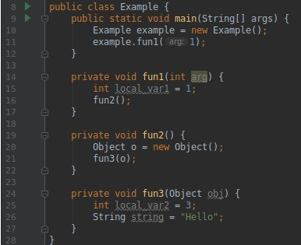
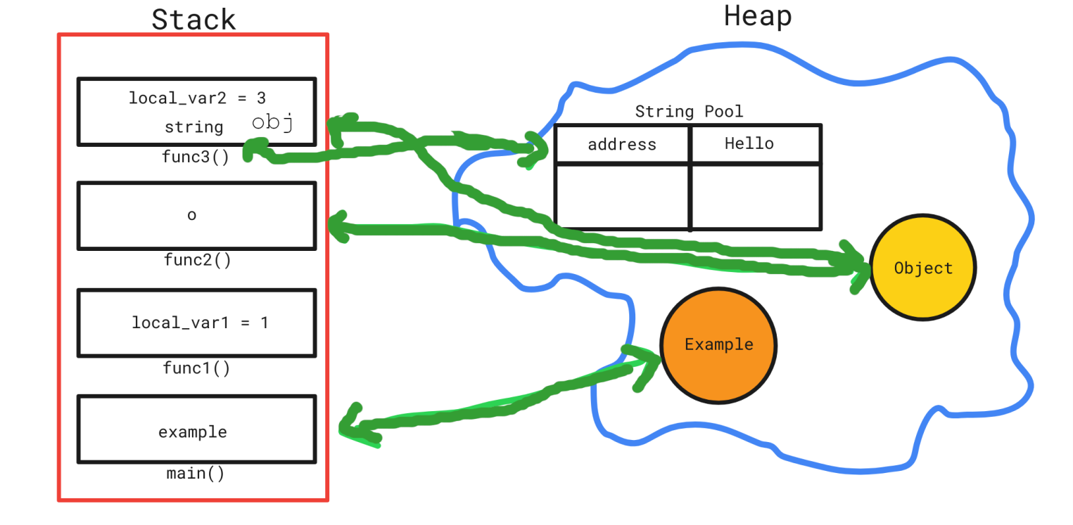

Slide 8
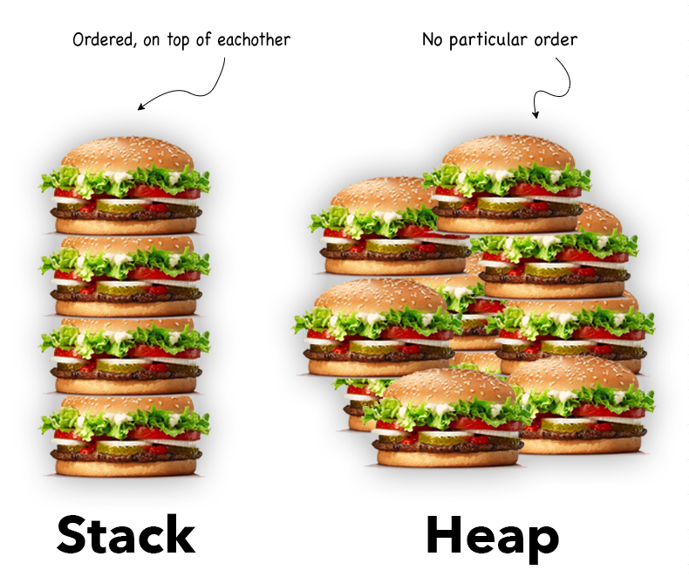
Some key Differences Between Stack and Heap Allocations
Stack Size Small than heap memory
Stack Allocation and De-allocation Automatic by compiler instructions.
Heap Allocation and De-allocation Manual by the programmer.
Accessing the time of heap takes is more than a stack.
Because stack is accessed in LIFO order while heap is accessed randomly.

Slide 9
Memory Management
Memory management is the process of allocating, de allocating, and managing memory resources in a program. It is an important aspect of programming, as it ensures that the program has enough memory to perform its tasks, and that memory is released when it is no longer needed, to prevent memory leaks and other issues.

Slide 10
Memory Management Type
Manual Memory Management: In this method, the programmer is responsible for allocating and de allocating memory manually. This is typically used in languages such as C and C++.
Automatic Memory Management: Some programming languages, such as Java , Python and dart .use automatic memory management, also known as garbage collection. The program automatically releases memory that is no longer in use, without the need for the programmer to manually deallocate it.

Slide 11
Garbage Collection
How does the garbage collector work? The garbage collector is looking for unused or unreachable objects. When there is an object in the heap that does not have any reference pointed to it, the garbage collector will take care of releasing it from memory and reclaim more space.
Memory management in Android:? Android uses a variant of the Dalvik Virtual Machine (DVM) called the ART (Android Runtime) which uses a garbage collector to automatically free up memory no longer in use. The garbage collector periodically checks for objects that are no longer being used by the application and frees up the memory associated with those objects.
Memory management in Flutter:? the Dart Virtual Machine (VM) is responsible for managing memory, and it uses a garbage collector to automatically reclaim unused memory. However, memory leaks can occur if objects are not properly released from memory, causing them to linger in the heap and consume resources

Slide 12
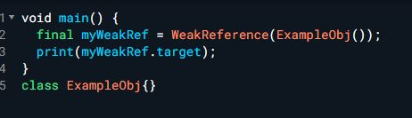

Notes
If a variable is defined, you must set it to Null in On Destroy.
If the variable identifier as a weak reference.
the Garbage Collection remove it from the Memory .
Weak Reference:?
Output

Slide 13


Slide 14
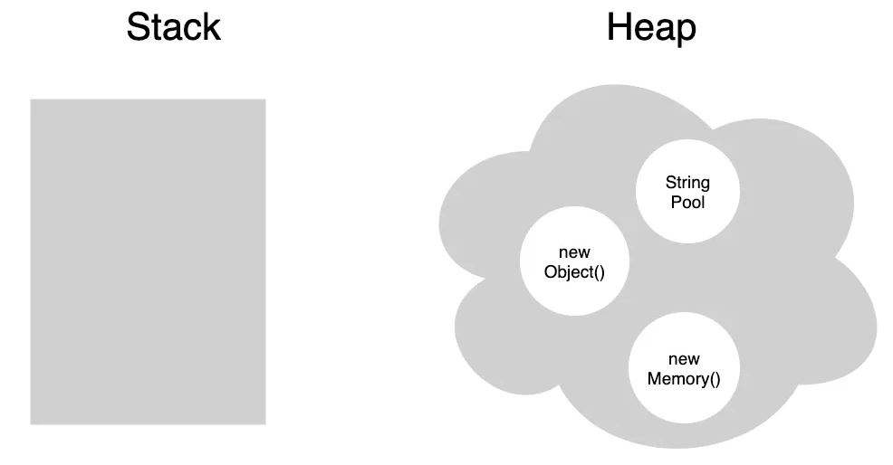
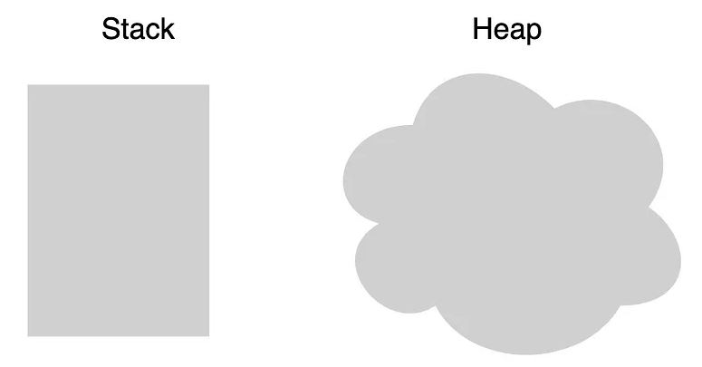
Example
What is the state of the memory before and after the GC operation?
Before
After
Garbage Collection

Slide 15
Some Reasons of Memory Leak
Unused Objects: unused objects that are not removed from memory can cause memory leaks
Improper Use of Streams: Streams are used in Flutter to handle asynchronous events, and improper use of streams can cause memory leaks. For example, not properly canceling a stream subscription can cause the stream to continue running in the background, consuming memory.
Large Images and Videos: Loading large images and videos can also cause memory leaks in Flutter. When large files are loaded, they take up a significant amount of memory, and if they are not properly released when they are no longer needed, they can cause memory leaks.

Slide 16
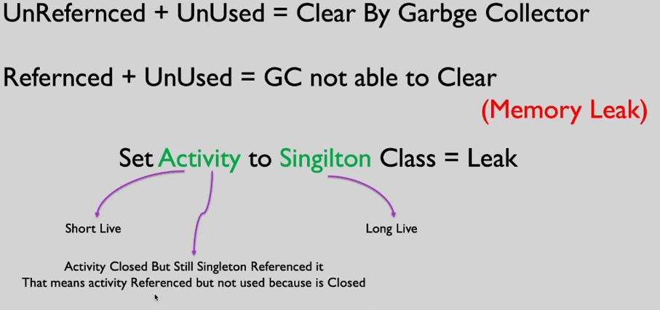
Examples

Slide 17
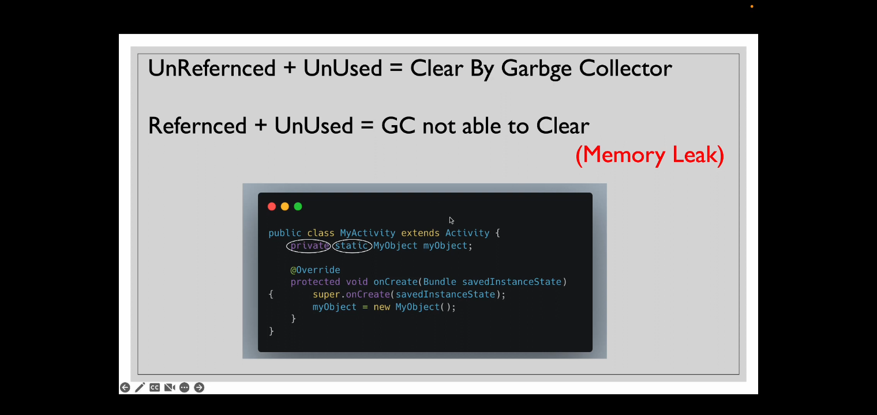

Slide 18
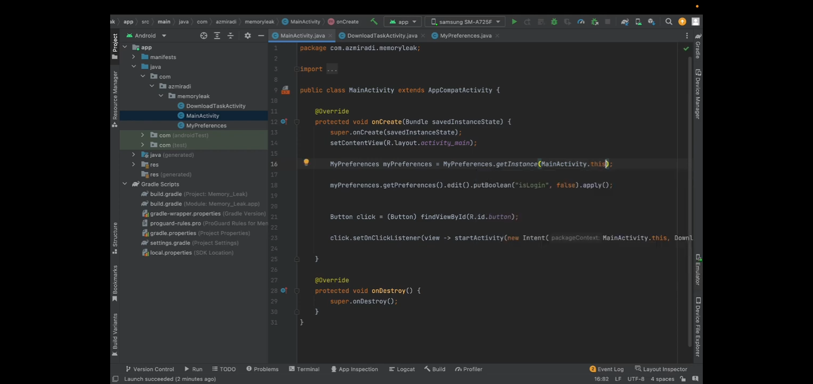
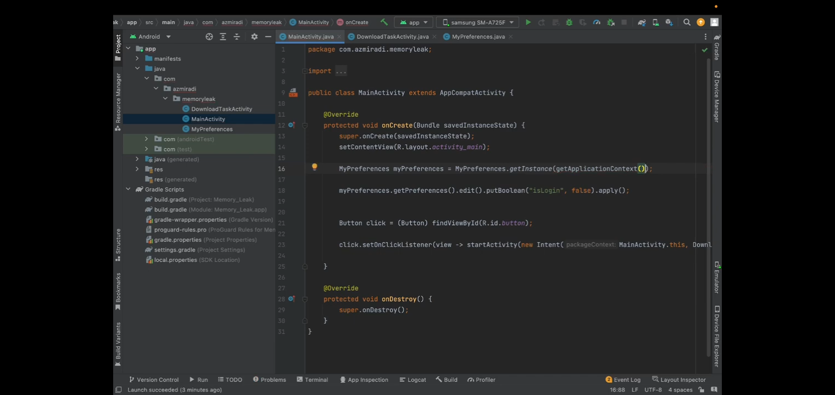

Slide 19
How to avoid Memory Leak
Dispose of Objects: One of the most effective ways to prevent memory leaks in Flutter is to dispose of objects when they are no longer needed.
Use Streams Properly: To prevent memory leaks caused by streams, always cancel the subscription when it is no longer needed. This ensures that the stream is no longer running in the background.
Use Images and Videos Efficiently: To prevent memory leaks caused by large images and videos, use efficient techniques to load them. One such technique is to use the flutter_cache_manager package, which helps to cache images and videos, reducing the amount of memory they consume.
Use Profiling Tools: Profiling tools, such as the Flutter DevTools, can help identify memory leaks in your application. By analyzing the memory usage of your application, you can pinpoint the areas that are causing memory leaks and take the necessary steps to fix them.

Slide 20
Conclusion:
Memory leaks are a common issue in Development, but they can be prevented by following best practices and using the appropriate tools. By disposing of objects, using streams properly, and efficiently loading images and videos, developers can prevent memory leaks and create high-performing applications that provide an optimal user experience. Remember to use profiling tools to identify memory leaks in your application, and take the necessary steps to fix them. With these tips, you can build Flutter applications that are fast, efficient, and reliable.
General Rule
Any class whose life is longer than a screen or activity, you should not use activity inside it because that make unused reference so happen memory leak.

Slide 21


Slide 22
References:
https://blog.devgenius.io/identifying-and-handling-memory-leaks-in-flutter-apps-1ad5e7d499e7 https://medium.com/geekculture/how-to-reduce-app-size-flutter-with-easy-steps-cb86c20f0b8c https://www.geeksforgeeks.org/ways-to-optimize-the-performance-of-your-flutter-application https://www.expertappdevs.com/blog/improve-flutter-app-performance https://docs.flutter.dev/perf/best-practices
https://www.raywenderlich.com/4690472-memory-leaks-in-android#toc-anchor-009
https://medium.com/@siddharthmakadiya/preventing-memory-leaks-in-flutter-best-practices-and-tools-293ddca1556e https://www.linkedin.com/pulse/understanding-memory-leaks-flutter-apps-nabraj-khadka https://stackoverflow.com/questions/57674085/how-to-find-memory-leaks-in-flutter
https://www.raywenderlich.com/4690472-memory-leaks-in-android#toc-anchor-009
https://www.raywenderlich.com/4690472-memory-leaks-in-android#toc-anchor-009
https://medium.com/@siddharthmakadiya/preventing-memory-leaks-in-flutter-best-practices-and-tools-293ddca1556e
https://pub.dev/packages/flutter_cache_manager

Slide 23
THANK YOU
Fady Zaher

